Slide 1
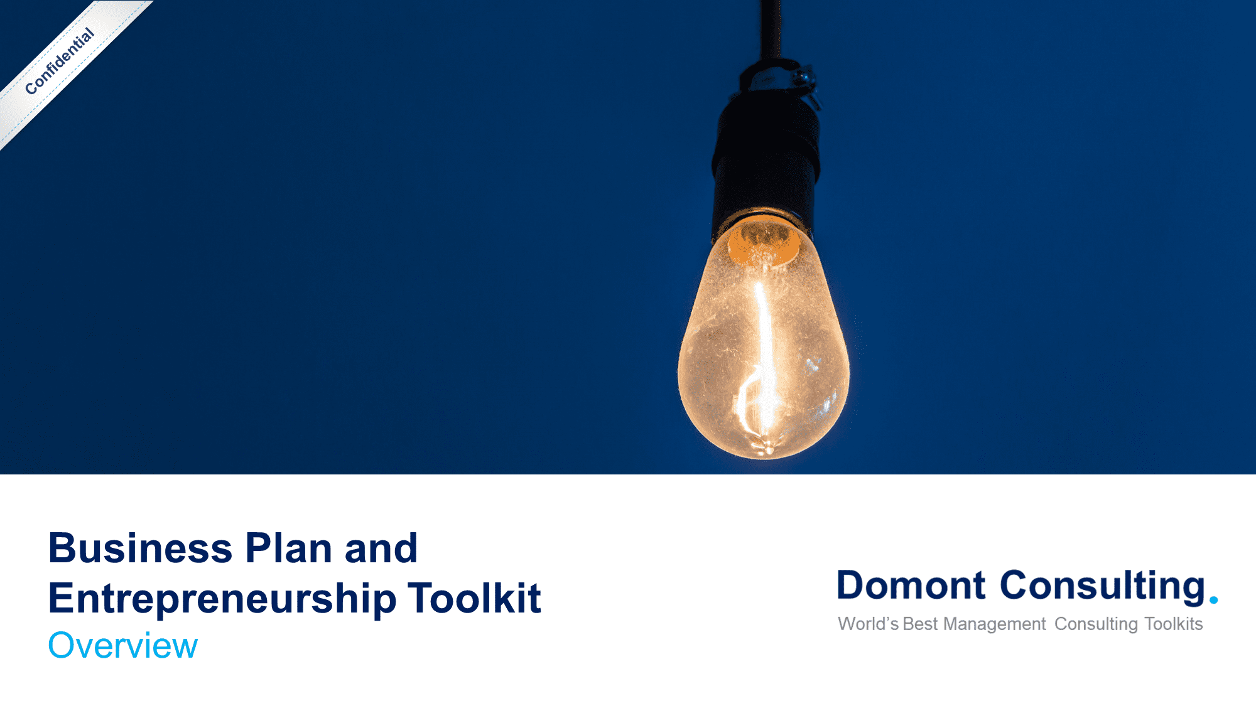
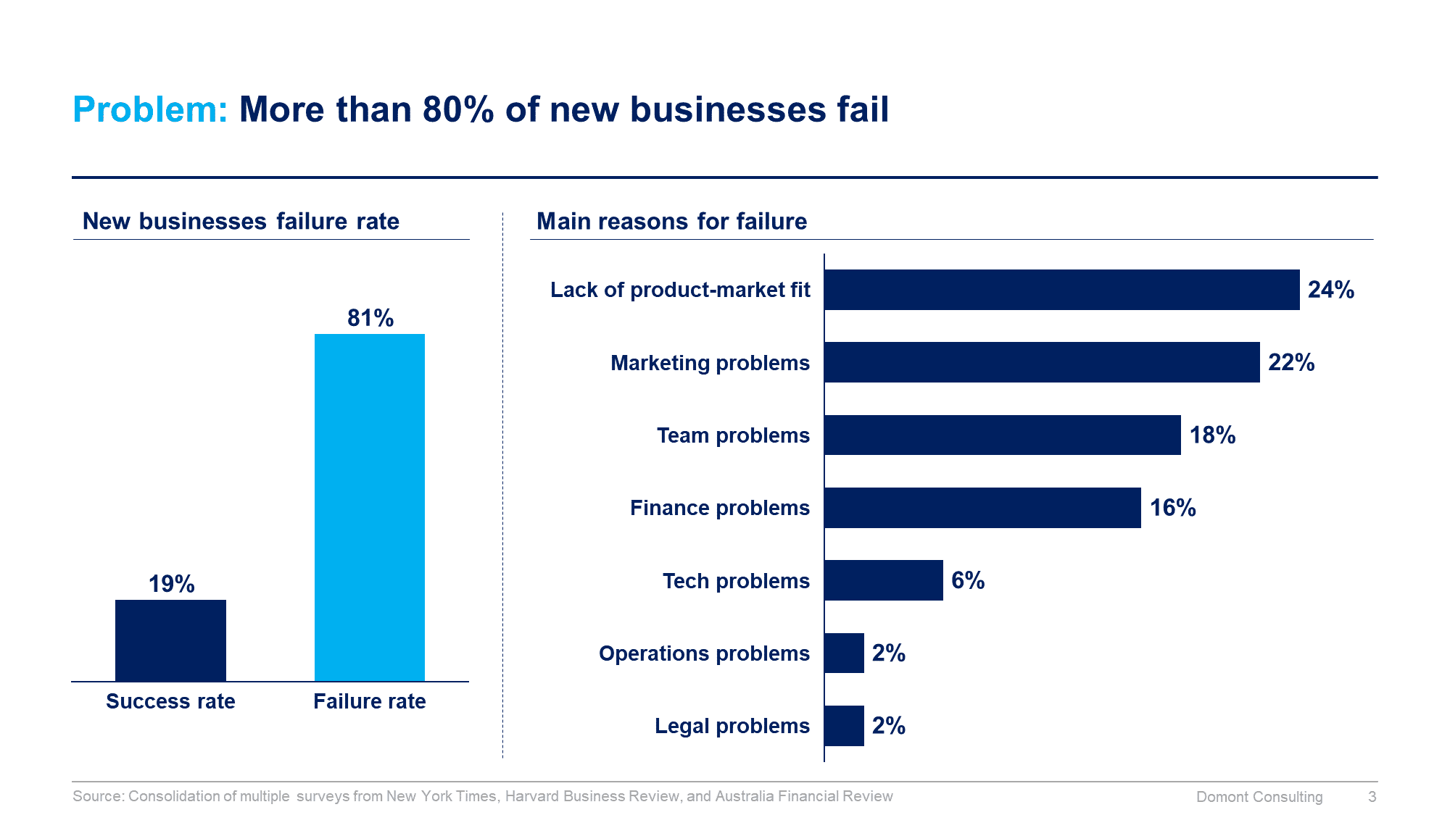
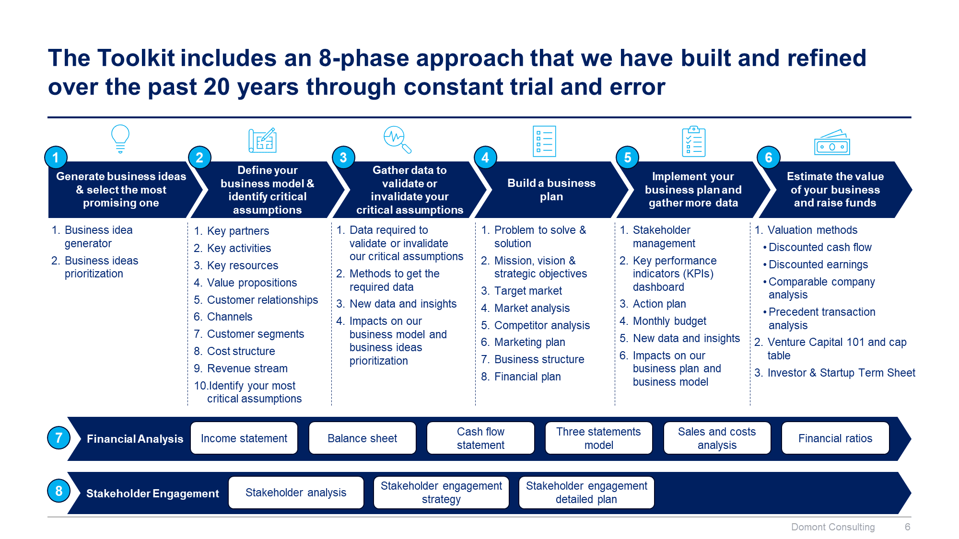
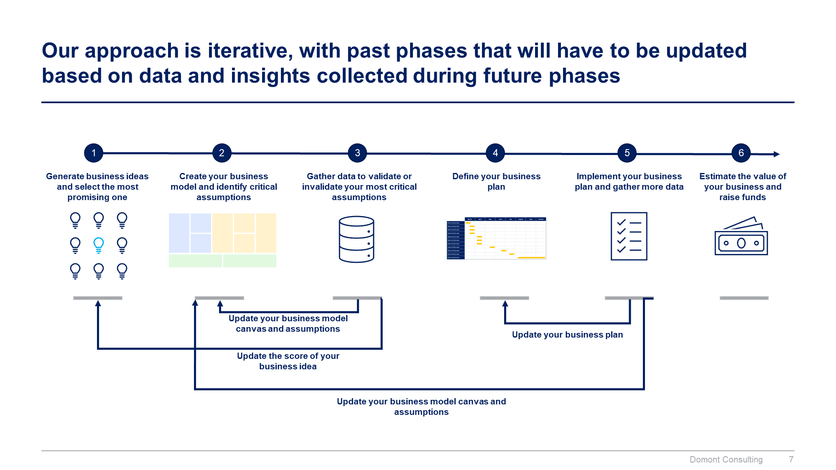
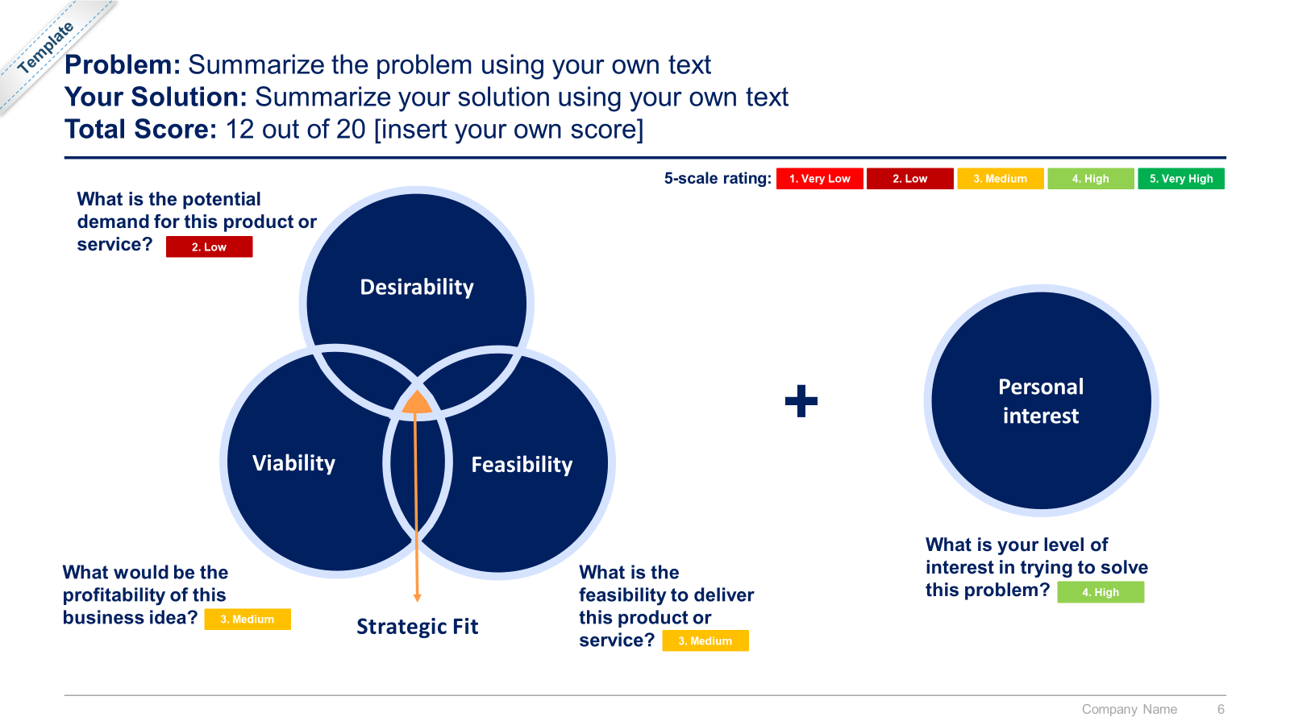
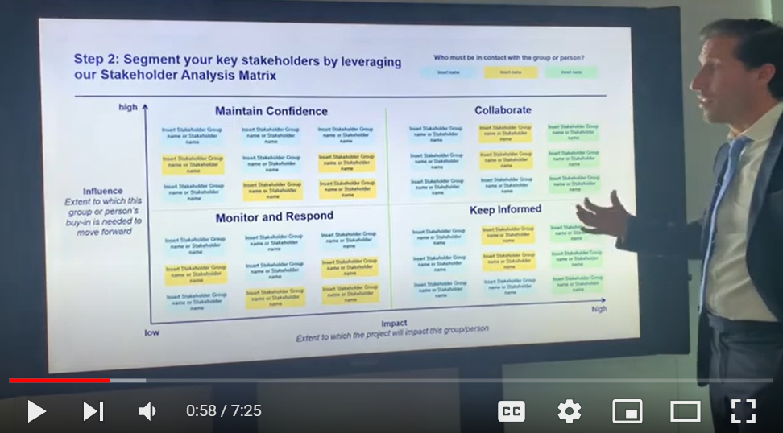
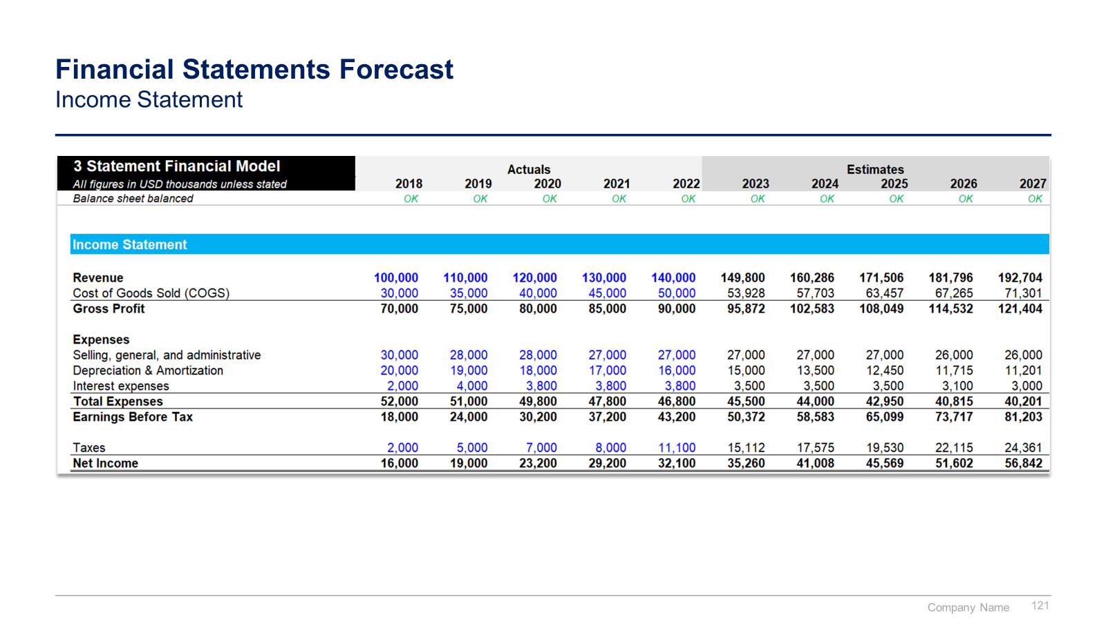
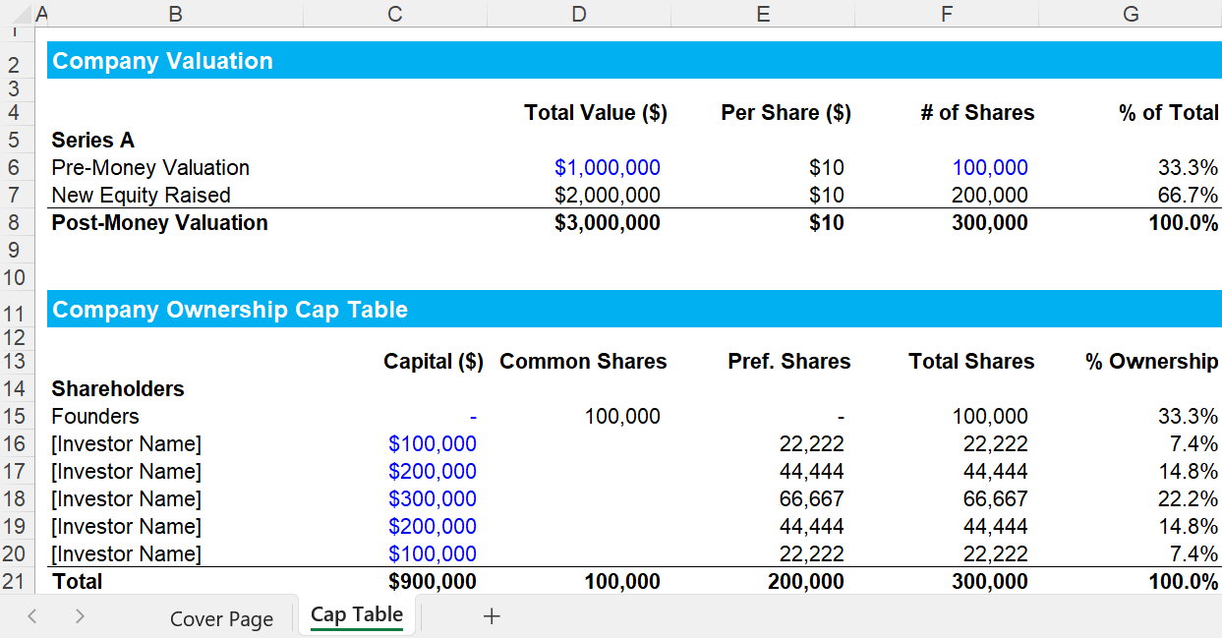
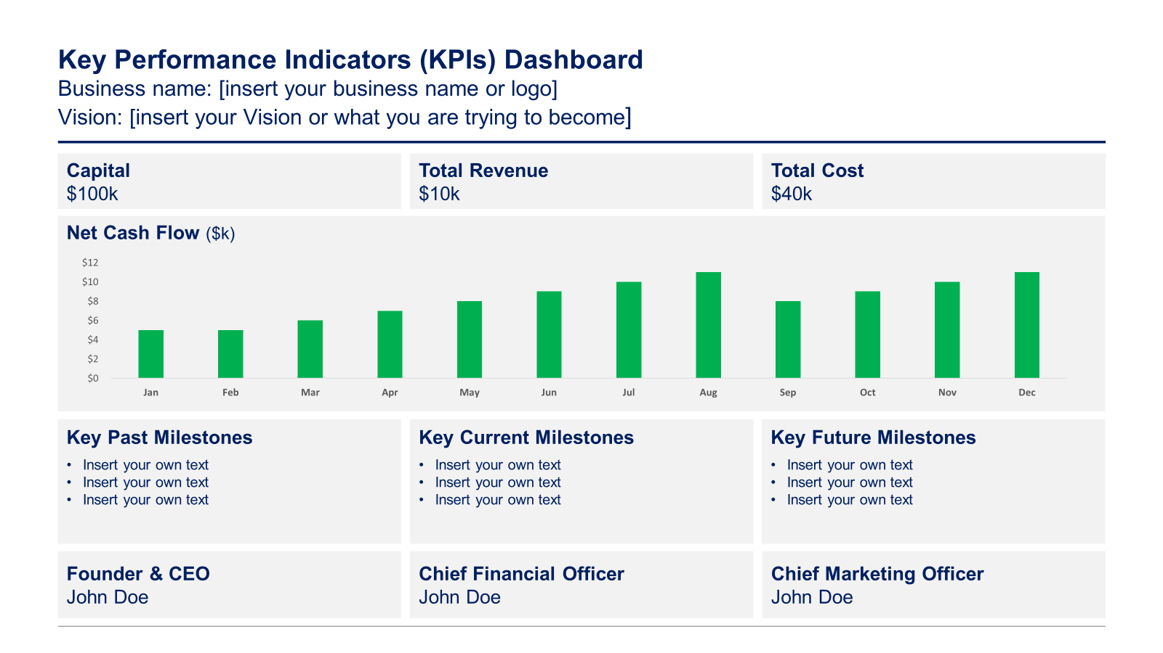

Slide 2

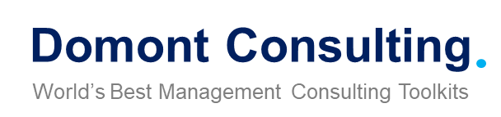
Confidential
Business Plan and Entrepreneurship Toolkit
Overview

Slide 3


Introduction
This Toolkit was created by ex-McKinsey, Deloitte and BCG Consultants and Entrepreneurs, after more than 4,000 hours of work. It is considered the world's best & most comprehensive Entrepreneurship Toolkit. It includes all the Frameworks, Tools & Templates required to build, run and scale your own Business and excel as an Entrepreneur.
Join the 200,000+ Executives, Consultants & Entrepreneurs who are already leveraging our Management Consulting Toolkits to improve the performance of their organization and boost their own career.
If you have any questions, send us an email at support@domontconsulting.com and one of our ex-McKinsey, Deloitte & BCG Management Consultants will get back to you within 2 business days.
Aurelien Domont
Management Consultant
Domont Consulting Managing Director

Slide 4



Context: The journey of transforming an innovative idea into a successful business involves navigating through several critical stages
1
2
3
4
Seed stage
Startup
Scaleup
Exit
Key Activities
Generate business ideas
Prioritize business ideas
Select the most promising one
Define your business model
Identify critical assumptions
Gather data to validate or invalidate your critical assumptions
Secure initial funding
Fine tune business model
Build a business plan
Secure venture capital
Implement your business plan
Hire key employees
Develop and sell your product or service
Fine tune business model and business plan
Raise additional funding
Scale operations
Expand market reach
Optimize processes
Strengthening the brand
Build strategic partnerships
Develop an exit strategy
Ensure all legal and regulatory requirements are met
Build hype and visibility around the company's exit
Finalize the exit
Revenue
Profit
No profit
No profit
Sometimes profitable
Often profitable
Source of Capital
Angel Investors
Friends and Family
Crowdfunding
Accelerators/Incubators
Venture Capital (VC) Firms
Government Grants and Subsidies
Corporate Investors
Later-stage Venture Capital
Private Equity
Debt Financing
Strategic Partnerships
Initial Public Offering (IPO)
Acquisition

Slide 5
Problem: More than 80% of new businesses fail
New businesses failure rate
Main reasons for failure
Lack of product-market fit
Marketing problems
Team problems
Finance problems
Tech problems
Operations problems
Success rate
Failure rate
Legal problems
Source: Consolidation of multiple surveys from New York Times, Harvard Business Review, and Australia Financial Review

Slide 6












Solution: Our consulting firm created the Business Plan and Entrepreneurship Toolkit to help you build, run, and scale your business
What’s inside the Toolkit?
Who created the Toolkit?
The Toolkit was created by ex-McKinsey, Deloitte & BCG Strategy Consultants.
Best Practices
Frameworks
Number of professionals leveraging our Toolkits
Advice from
tier-1 Management Consultants
Tools
There are 200,000+ Executives, Consultants & Entrepreneurs leveraging our Toolkits to improve the performance of their organization
Real-life Examples
Templates
Trusted by small and large organizations
Video Training
Step-by-step Tutorials

Slide 7
Our Toolkit will help you fulfill multiple objectives
The Business Plan and Entrepreneurship Toolkit includes frameworks, tools, templates, tutorials, real-life examples, video training, and best practices to help you:
Build, run, and scale your own business with our practical 8-phase approach: (I) Generate business ideas and select the most promising one, (II) Define your business model and identify critical assumptions, (III) Gather data to validate or invalidate your critical assumptions, (IV) Build a business plan, (V) Implement your business plan and gather more, (VI) Estimate the value of your business and raise funds, (VII) Carry out a financial analysis, (VIII) Engage stakeholders
(I) Generate business ideas and select the most promising one: (1) Business idea generator, (2) Prioritization of business ideas
(II) Define your business model and identify your critical assumptions: (1) Key partners, (2) Key activities, (3) Key resources, (4) Value propositions, (5) Customer relationships, (6) Channels, (7) Customer segments, (8) Cost structure, (9) Revenue stream, (10) Critical assumptions
(III) Gather data to validate or invalidate your critical assumptions: (1) Data required to validate or invalidate our critical assumptions, (2) Methods to get the required data, (3) New data and insights, (4) Impacts on our business model, (5) Impacts on our business ideas prioritization
(IV) Build a business plan: (1) Problem to solve and solution, (2) Mission, vision, and strategic objectives, (3) Target market, (4) Market analysis, (5) Competitor analysis, (6) Marketing plan, (7) Business structure, (8) Financial plan
(V) Implement your business plan and gather more data along the way: (1) Key performance indicators dashboard, (2) Action plan, (3) Monthly budget to monitor the expenses and the revenue of your venture, (4) New data and insights, (5) Impacts on our business plan and business model
(VI) Estimate the value of your business and raise funds: (1) Valuation methods including discounted cash flow valuation model, precedent transaction analysis and comparable company analysis, (2) Venture capital 101 and cap table (3) Investor and startup term sheet: Post-money valuation, Amount of financing, Size of option pool, Vesting periods, Board representation, and a summary of all the terms and pitfalls to avoid
(VII) Carry out a financial analysis: (1) Income statement, (2) Balance sheet, (3) Cash flow statement, (4) Three statements model, (5) Sales and costs analysis, (6) Financial ratios
(VIII) Engage your stakeholders effectively: (1) Stakeholder analysis, (2) Stakeholder engagement strategy, (3) Stakeholder engagement detailed plan

Slide 8

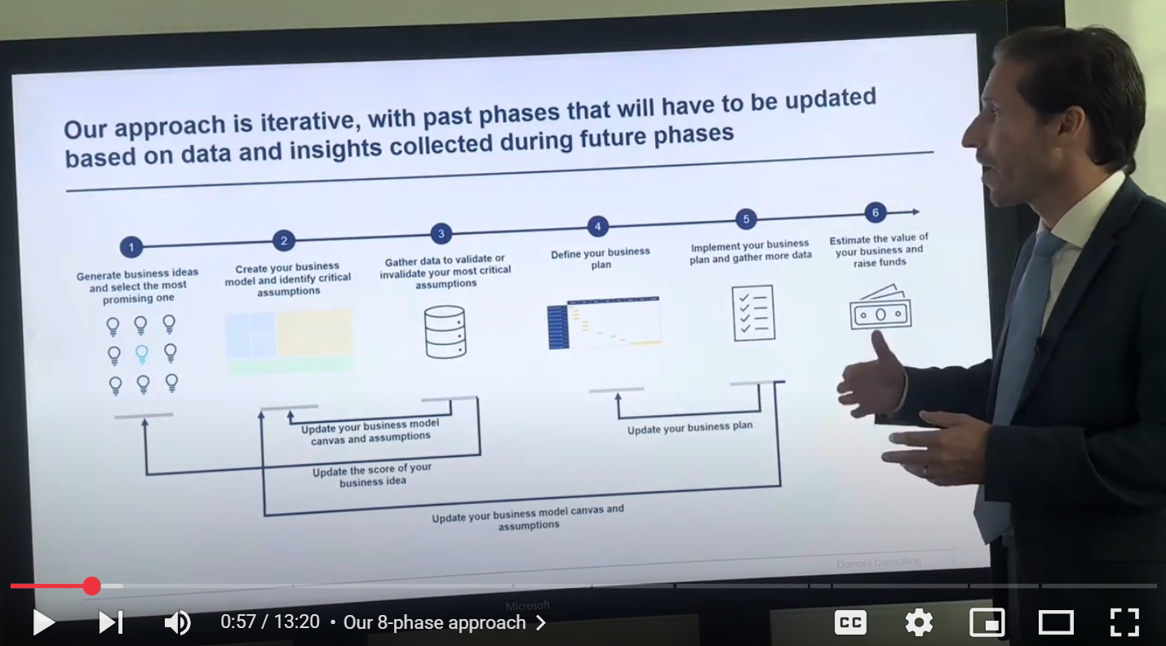
Video demonstration of the Business Plan and Entrepreneurship Toolkit
Video Demo Access
Video Demo Visual
Select “Slide Show” mode and then click on the link below or on the image on the right to access this video demo.
You can also access the video by copy pasting the following URL in your browser:
https://youtu.be/3y7_ehU9jus

Slide 9






The Toolkit includes an 8-phase approach that we have built and refined over the past 20 years through constant trial and error
1
2
3
4
5
6
Generate business ideas & select the most promising one
Define your business model & identify critical assumptions
Gather data to validate or invalidate your critical assumptions
Build a business plan
Implement your business plan and gather more data
Estimate the value of your business and raise funds
Business idea generator
Business ideas prioritization
Key partners
Key activities
Key resources
Value propositions
Customer relationships
Channels
Customer segments
Cost structure
Revenue stream
Identify your most critical assumptions
Data required to validate or invalidate our critical assumptions
Methods to get the required data
New data and insights
Impacts on our business model and business ideas prioritization
Problem to solve & solution
Mission, vision & strategic objectives
Target market
Market analysis
Competitor analysis
Marketing plan
Business structure
Financial plan
Stakeholder management
Key performance indicators (KPIs) dashboard
Action plan
Monthly budget
Executive dashboard
New data and insights
Impacts on our business plan and business model
Valuation methods
Discounted cash flow
Discounted earnings
Comparable company analysis
Precedent transaction analysis
Venture Capital 101 and cap table
Investor & Startup Term Sheet
Financial Analysis
7
Income statement
Balance sheet
Cash flow statement
Three statements model
Sales and costs analysis
Financial ratios
Stakeholder Engagement
8
Stakeholder analysis
Stakeholder engagement strategy
Stakeholder engagement detailed plan

Slide 10




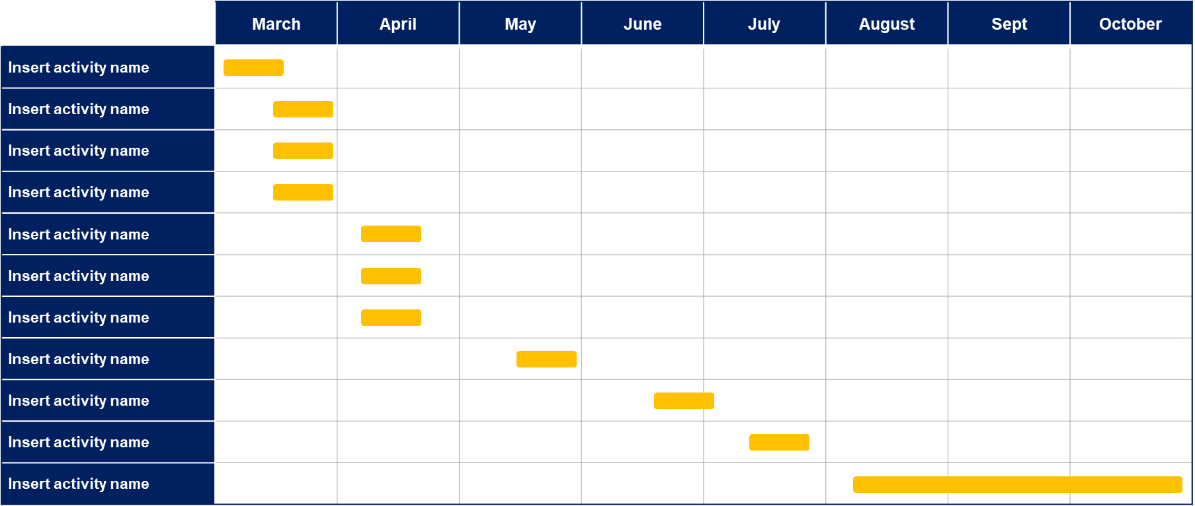

Our approach is iterative, with past phases that will have to be updated based on data and insights collected during future phases
1
2
3
4
5
6
Generate business ideas and select the most promising one
Create your business model and identify critical assumptions
Gather data to validate or invalidate your most critical assumptions
Define your business plan
Implement your business plan and gather more data
Estimate the value of your business and raise funds
Update your business model canvas and assumptions
Update your business plan
Update the score of your business idea
Update your business model canvas and assumptions

Slide 11
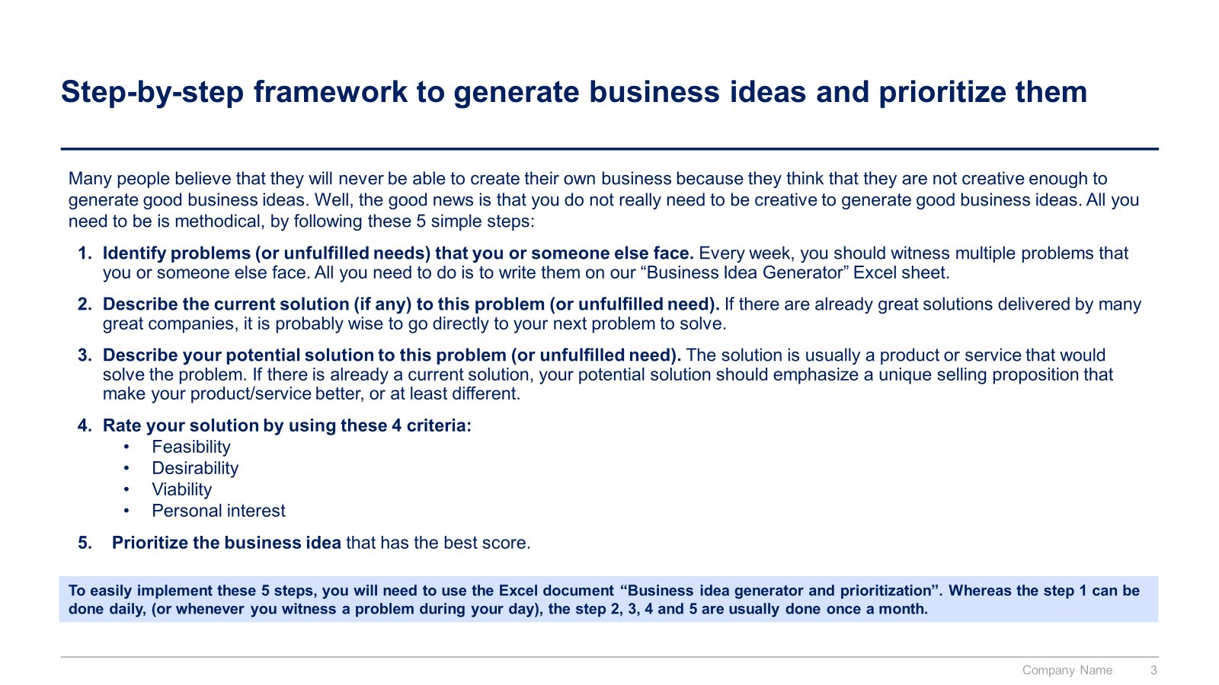
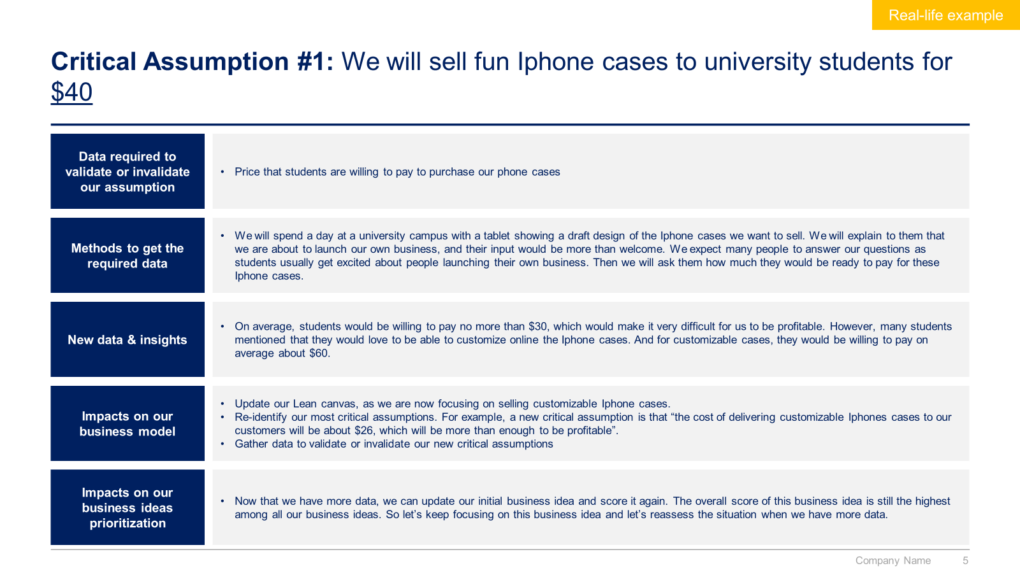
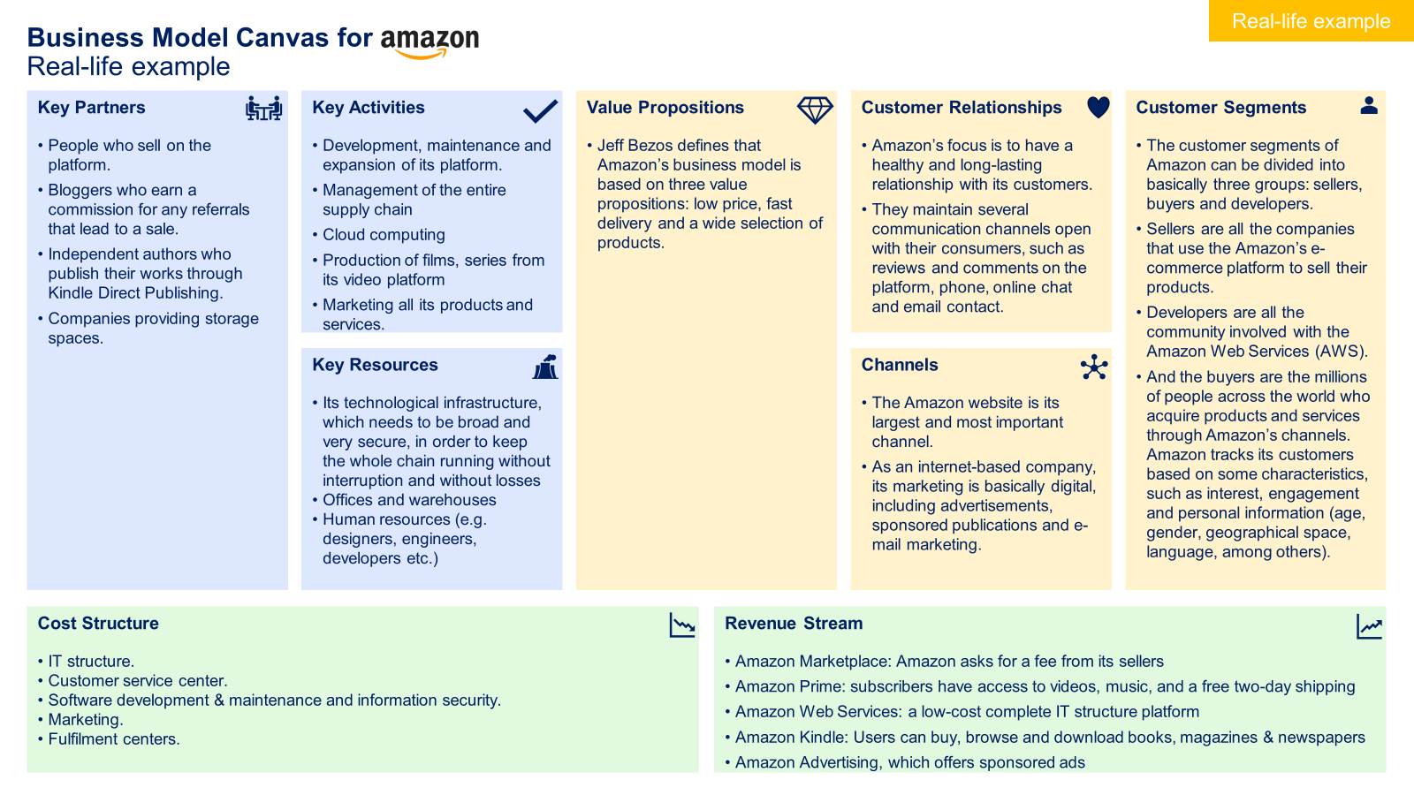
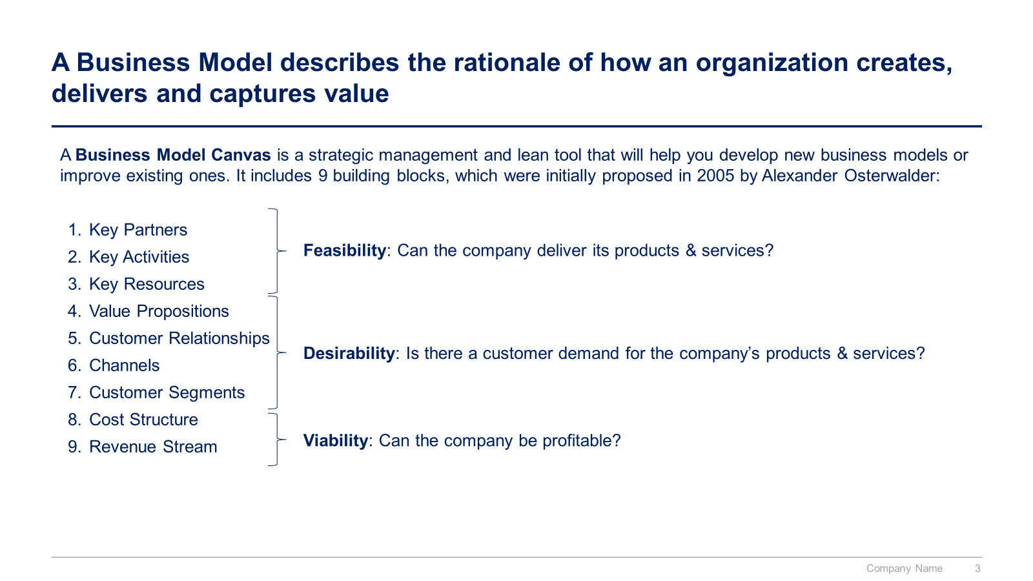
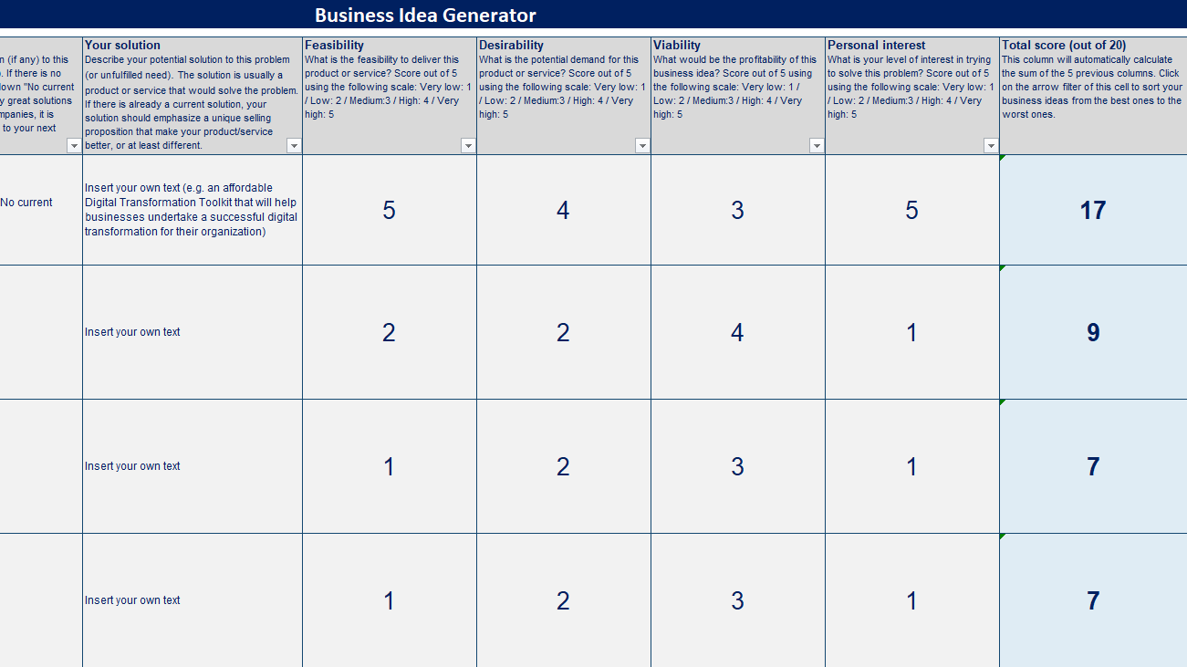
Small preview of phase 1, 2 and 3

Slide 12
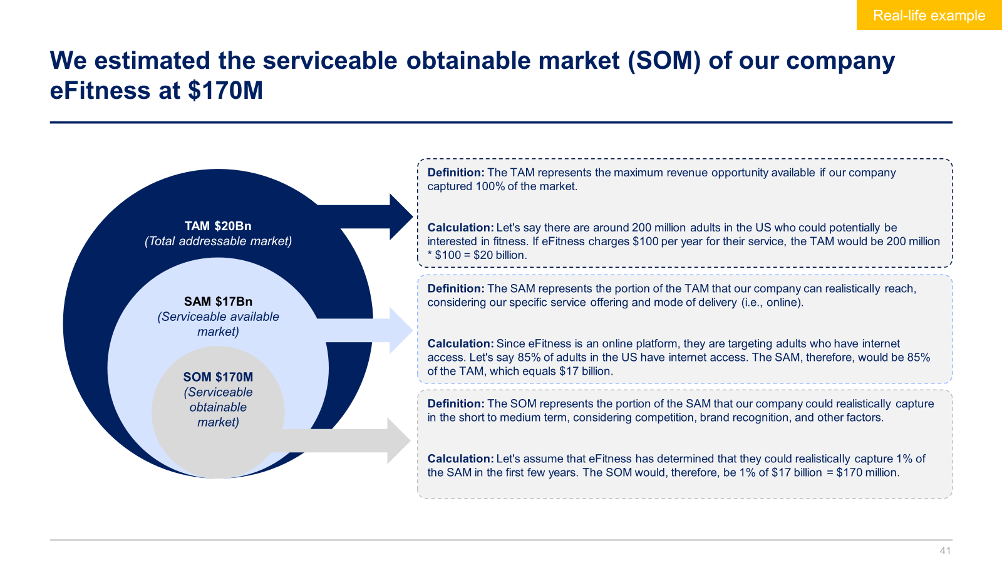
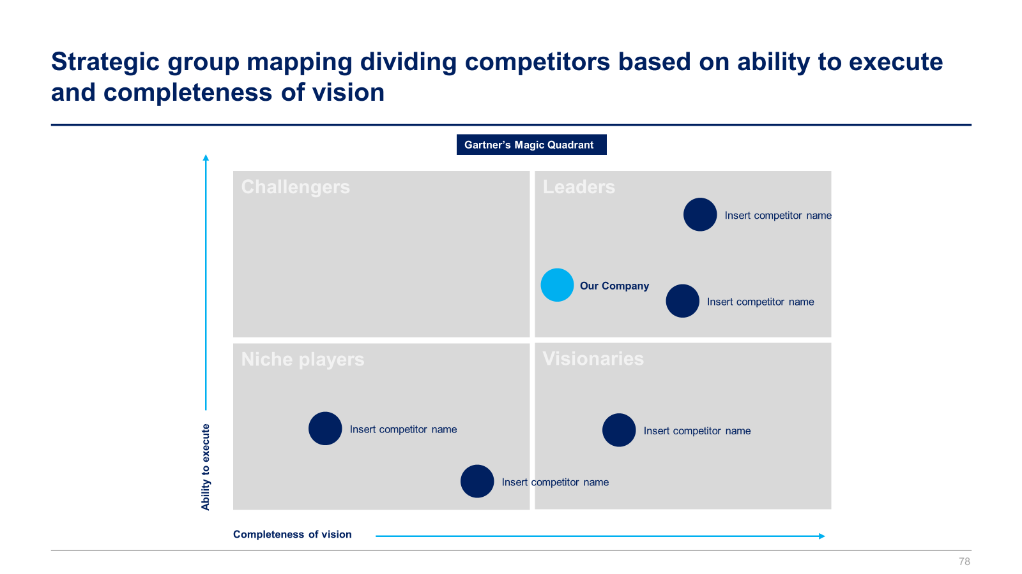
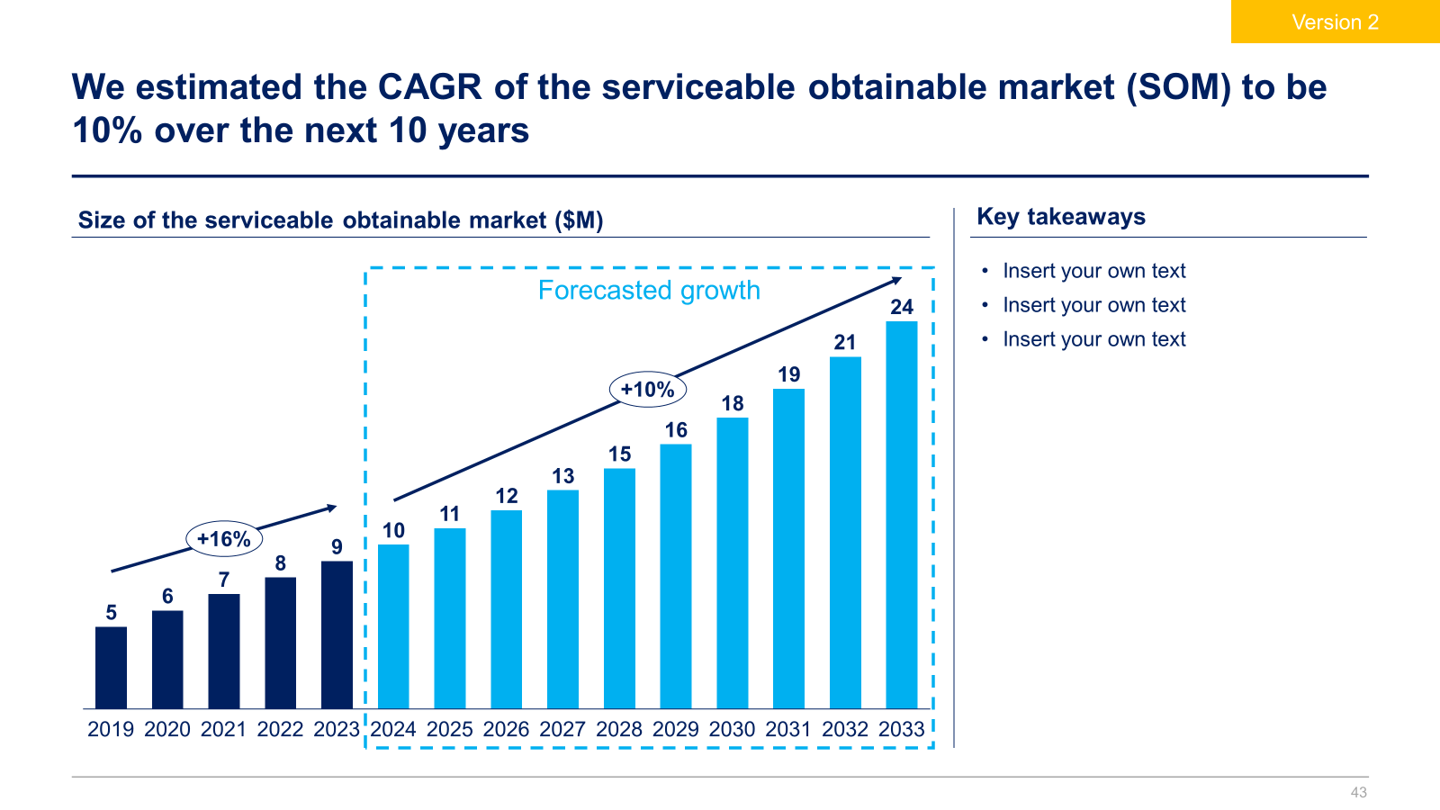
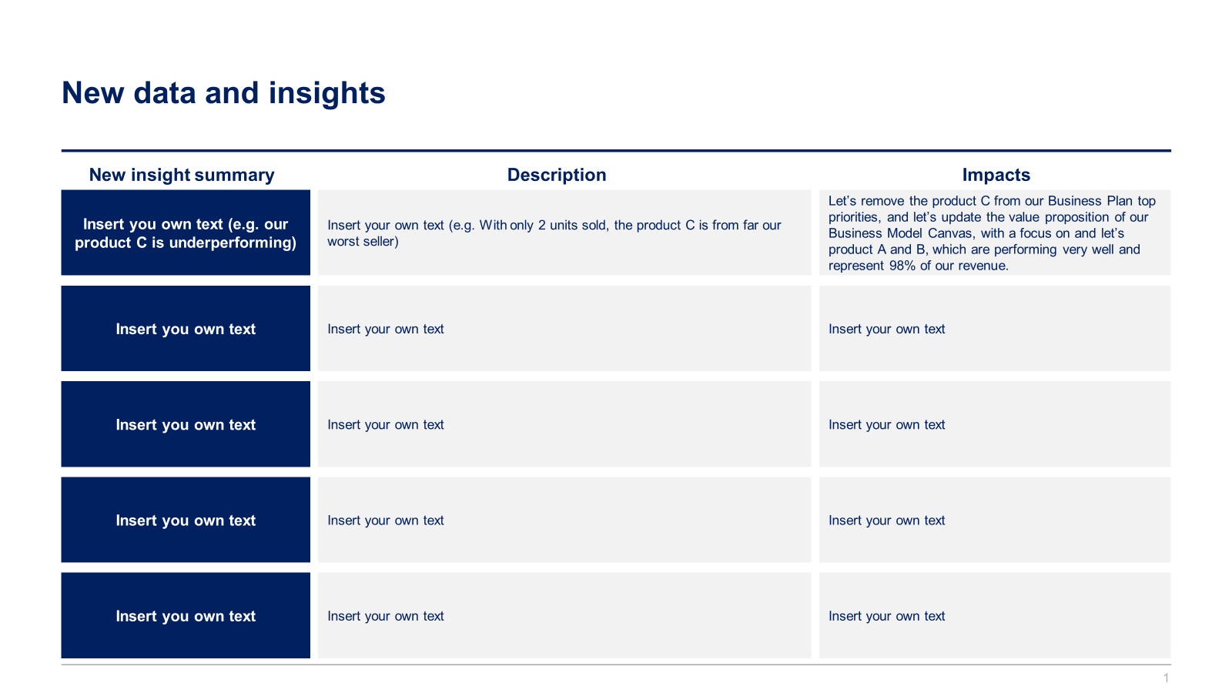
Small preview of phase 4 and 5

Slide 13
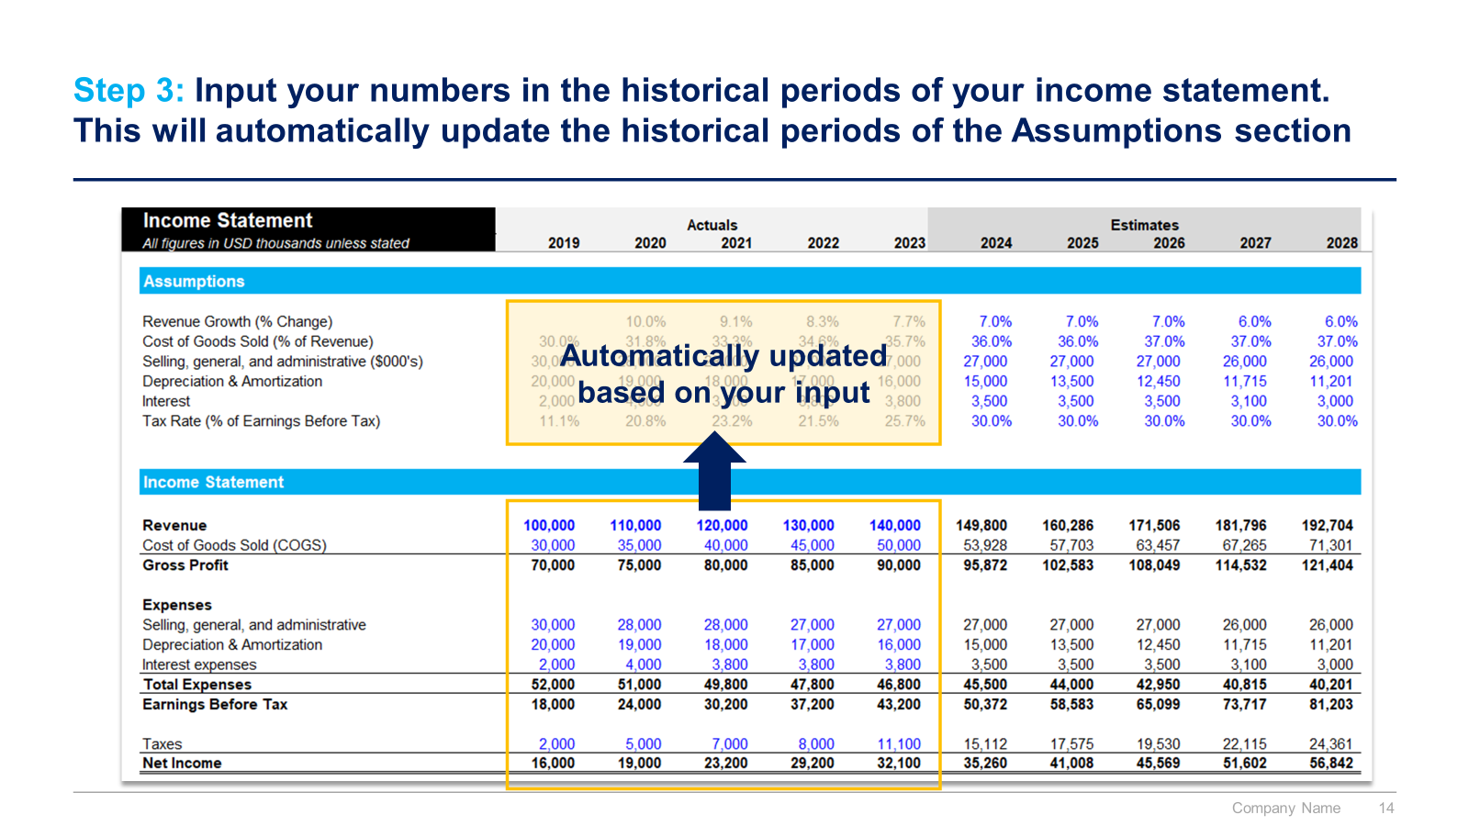
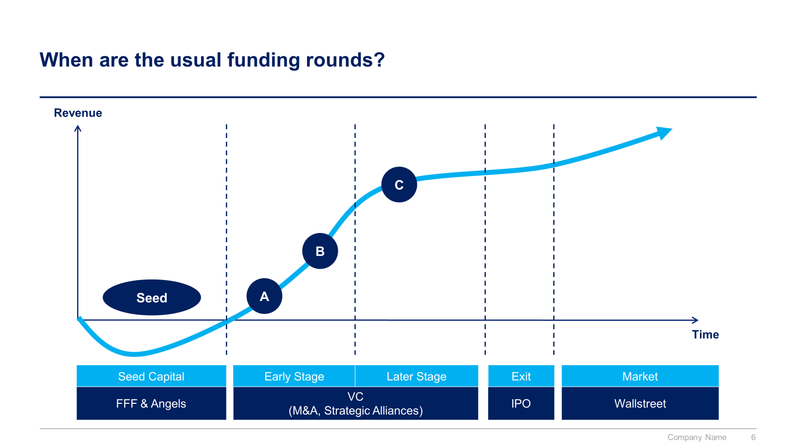
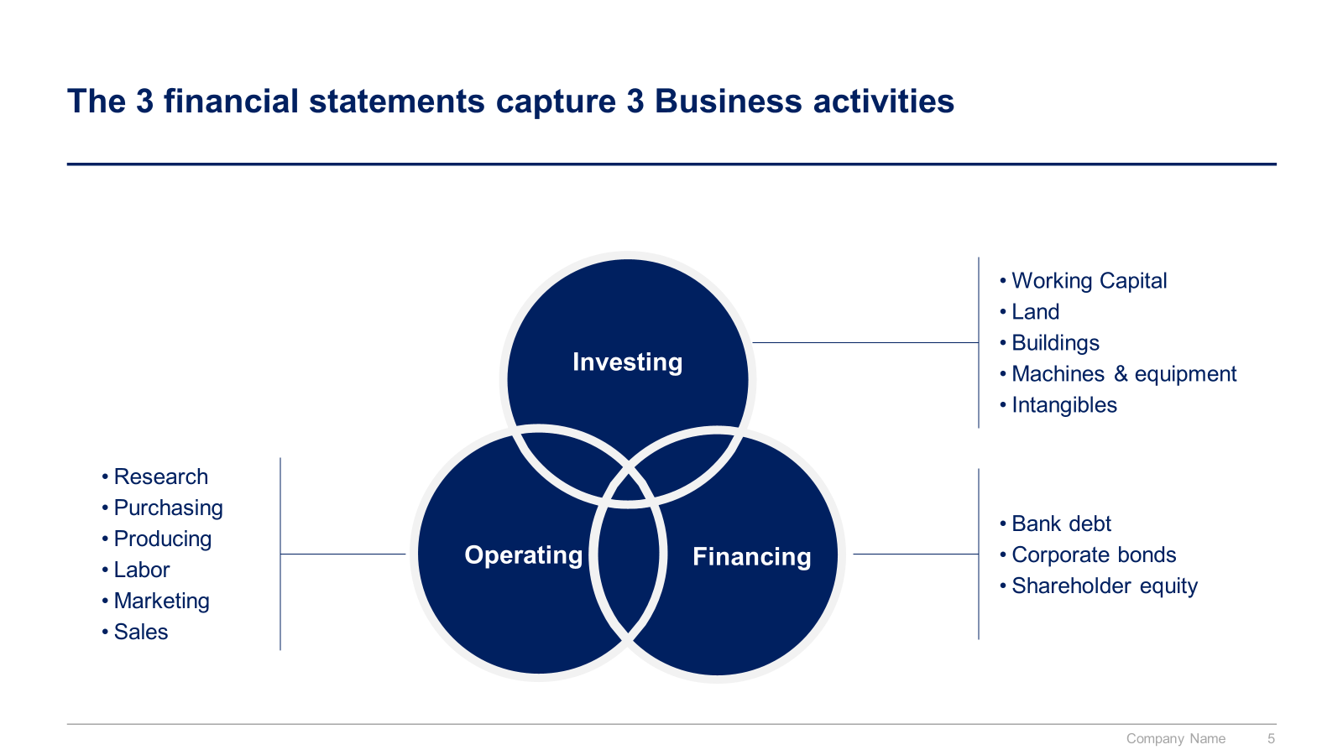
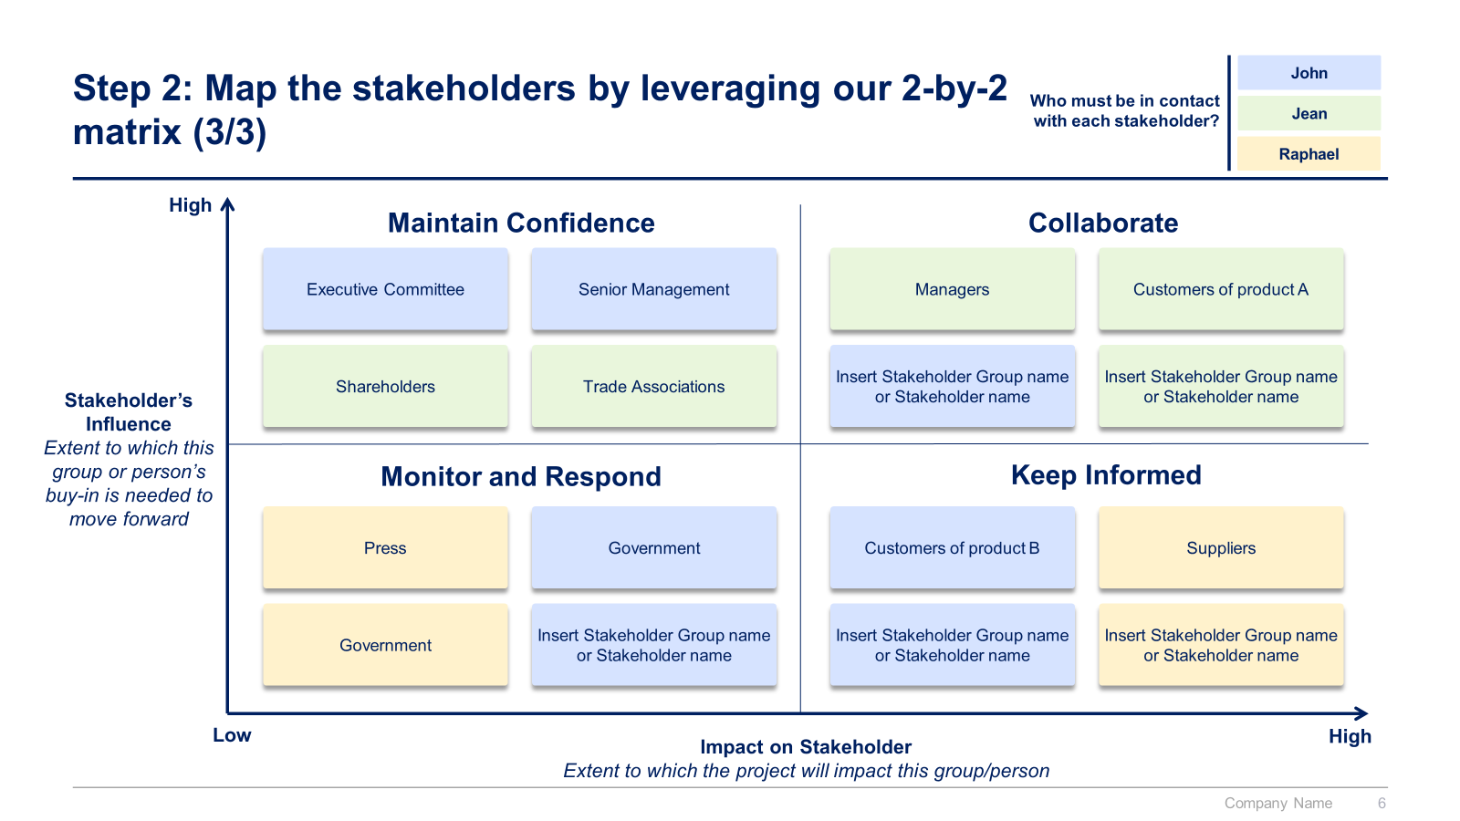
Small preview of phase 6, 7 and 8

Slide 14



The Toolkit includes multiple PowerPoint slides, Excel sheets and Video training that you can download on your device immediately after purchase
300 editable PowerPoint slides*
32 Excel sheets*
31 minutes of Video training
10 Word pages
*Please note that the number of Powerpoint slides and Excel sheets listed is the number of unique slides and sheets. For example, a Powerpoint slide that has been duplicated to facilitate our clients’ understanding only counts for one slide

Slide 15









Our Management Consulting Toolkits include 9 key benefits
Improve the growth & efficiency of your organization by leveraging Management Consulting Toolkits created by ex-McKinsey, Deloitte & BCG Consultants.
Make a great investment for your career & organization. It cost us US$8M+ over the past 10 years to create all our Toolkits. Get them for a fraction of this cost.
Get a competitive advantage. It’s like hiring Management Consultants to create all the practical Frameworks, Tools & Templates you need.
Get the job done quicker and never start from scratch again with our ready-made and fully editable Frameworks, Tools & Templates in Powerpoint & Excel.
Don't reinvent the wheel. We have already worked 30,000+ hours over the past 10 years to create all the Management Consulting Toolkits you need.
Improve the capabilities of your organization by learning how the Fortune 100 and Global Consulting Firms do it.
Decrease your costs. Hiring tier-1 Consultants for a project would cost you $300k+. Way more expensive than our Toolkits, which will last you a lifetime!
Become your organization’s subject matter expert and impress your stakeholders with world-class approaches to resolve common business problems.
Get free support and advice from our ex-McKinsey, Deloitte & BCG Management Consultants.

Slide 16
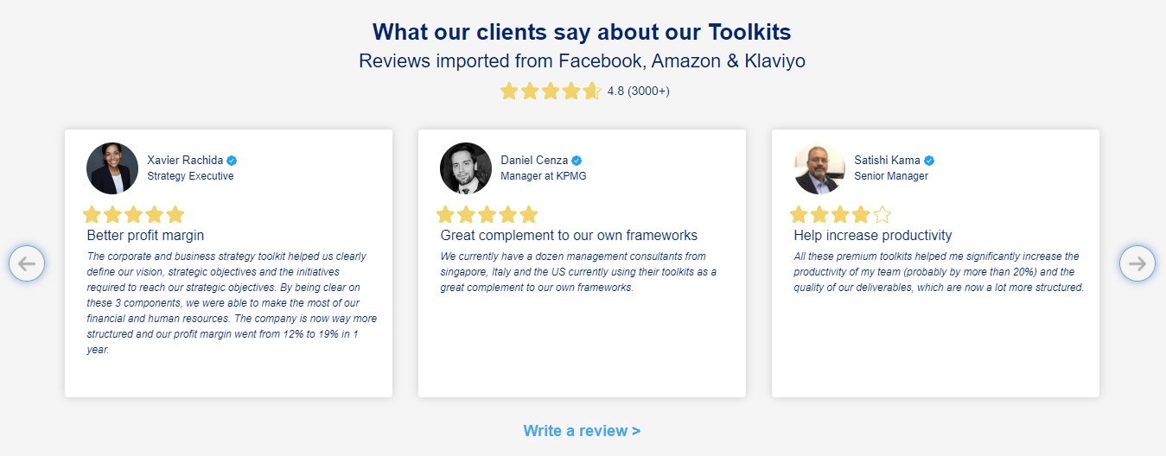
What our clients say about our Toolkits
Click here to see more reviews >

Slide 17

Join 200,000+ Executives, Consultants & Entrepreneurs leveraging our Toolkits to improve the performance of their organization
Trusted by small and large organizations
Customer satisfaction
4.8
Number of countries leveraging our Toolkits
160+
Number of professionals leveraging our Toolkits
200,000+
Daily rate of our ex-McKinsey, Deloitte and BCG Management Consultants
$3k-$4k

Slide 18

Interested in more than 1 Toolkit? Access all our Toolkits for half the price with our Gold Access
Gold Access
Click here to learn more

Slide 19

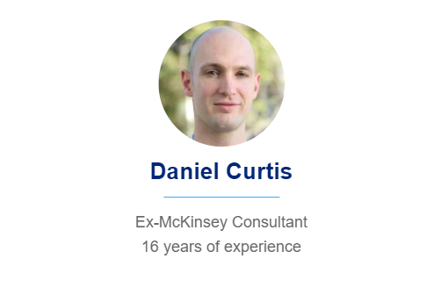
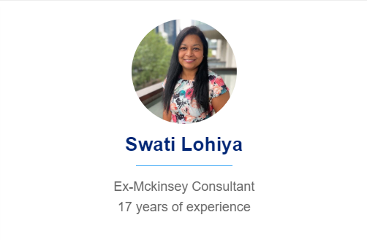

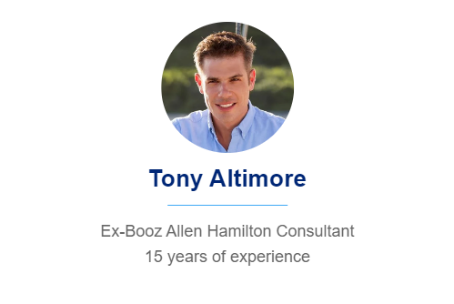
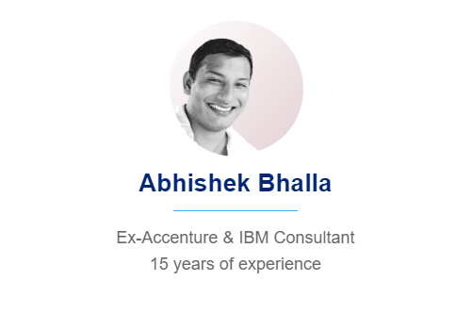
Need additional help? Send us a brief and we’ll find you the right talent from our network of 500+ tier-1 Management Consultants
Click here to send us a Project Brief

Slide 20
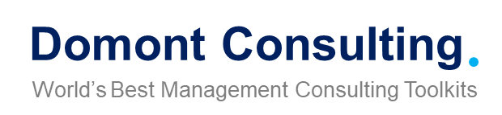
This was just a small preview.
www.domontconsulting.com

